Slide 1

Machine Learning Methods in Genealogical Research
Ildikó Szerényi and Zoltán Szatucsek
National Archives of Hungary
Trnava / Slovakia
25-26 September 2025

Slide 2
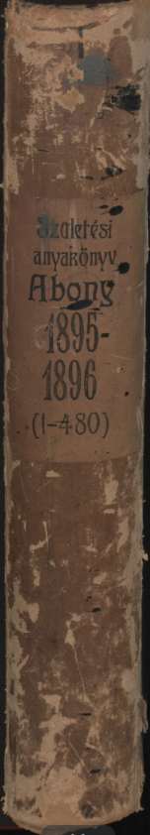
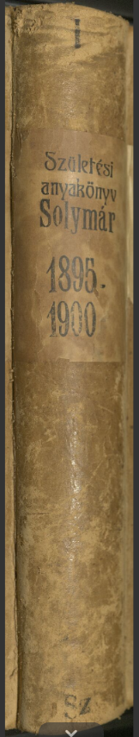
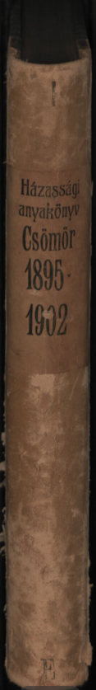
Objectives and Focus Areas of the Development
Current focus: civil register sources → digitization, processing, publication
Main components of the project:
Publication of digitized images and metadata
Full-text recognition (with Handwritten Text Recognition – HTR)
Structured recognition (with Handwritten Text Recognition – HTR)
Notes:
Right now, our main focus is on civil register sources. That’s why most of our development work is about digitizing, processing, and publishing these records. The civil register project is one of the biggest project we’ve had in recent years. It’s quite complex, so it needs careful attention and oversight. Since it’s a multi-year project, we share results gradually, giving researchers new opportunities to explore as we go.
First step – Publication of digitized images and metadata This means we publish the scanned images of the parish registers, together with some basic information, like the title, the year, or the place.
Second step – Full-text recognition with Handwritten Text Recognition, or HTR Here, Artificial Intelligence actually “reads” the handwriting and turns it into digital text, so we can search in it just like in a normal document.
Third step – Structured recognition with HTR This is a more advanced step. AI doesn’t just transcribe the whole text, it also organizes the information into fields. For example, in a birth record: the name, the year, the place – each goes into its own category, so we can build a searchable database.
In my presentation, I’ll also point out some interesting technical details to show both the complexity of the project and the challenges our development team deals with.

Slide 3
Civil registers
Original duplicate copies are owned by the National Archives of Hungary → freely publishable on the DatabasesOnline portal, in compliance with legal regulations (www.adatbazisokonline.hu)
Advantages of processing civil registers:
Strong research interest
Unified, structured format
Records in Hungarian
Both protocol-style and tabular formats → processed in parallel
Time span: 1895–1980
Scope: 37,611 volumes from 3,422 settlements in Hungary
Digitization output: approx. 22 million images expected
Notes:
The original duplicate copies of civil registers are kept by the National Archives of Hungary (MNL). Following legal rules, these records can be freely published on the MNL’s AdatbázisokOnline portal.
Working with civil registers has many advantages: there is strong research interest in them, they provide a unified and structured format, and the registers are all in Hungarian. They exist in both protocol-style and tabular formats, and we process both formats in parallel.
The registers cover the years 1895–1980. In total, there are 37,611 volumes from 3,422 settlements across Hungary. During digitization, we expect to create around 22 million images.

Slide 4
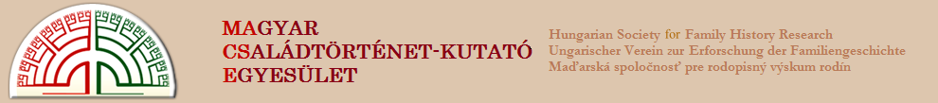

Collaboration
Volunteers from MACSE (Hungarian Society for Family History Research)
High level of genealogical expertise
Demonstrated commitment and dedication
Provided significant support to project workflows
Notes:
The civil register project has greatly benefited from the support of volunteers from MACSE (Hungarian Society for Family History Research). Their genealogical expertise and dedication have been crucial in helping us with the workflows.

Slide 5
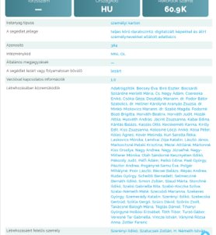
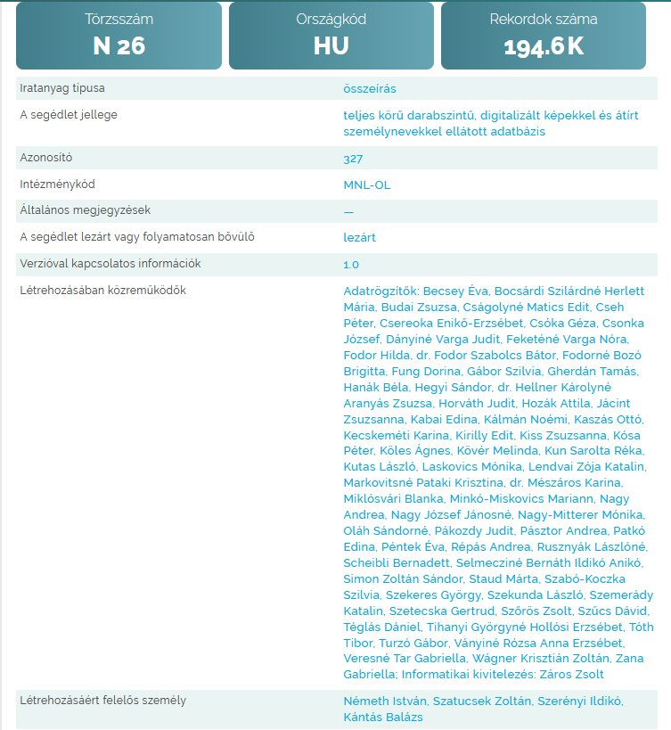
Informational pages of the published databases
Notes:
We wished to express our thanks by listing all their names among the database creators which are already published.
The two published databases are the Census of 1828 and the Secret Service database.

Slide 6
Digitization and Image-Based Access
Nationwide digitization in progress → step by step, county by county
Pest County volumes already digitized and published
Freely accessible under legal regulations
Restricted data → only metadata shown, padlock icon indicates limited access
Currently available in image format
Structured processing & searchability → under development
Notes:
Digitization and Image-Based Access to Civil Registers
The Archives are currently digitizing and publishing civil registers nationwide, working county by county.
Volumes from Pest County have already been digitized.
For records with research restrictions, only metadata is available, and a small padlock icon in the database shows limited access.
Right now, the material is available in image format, while structured processing and searchability are still being developed.

Slide 7
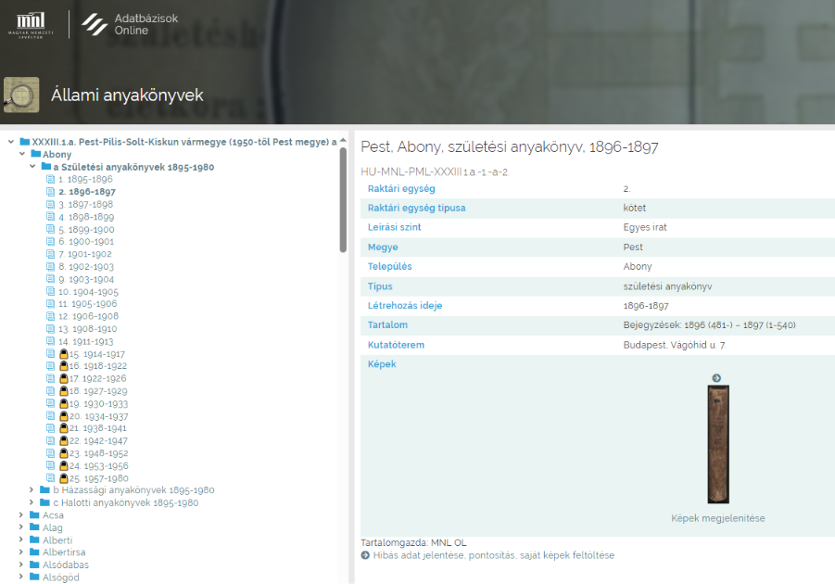
Pest County published - padlock icon indicates limited access
Notes:
On this image, you can see what the interface looks like.

Slide 8
Upcoming Civil Register Publications
Preparations are underway for the publication of civil registers from the following counties:
Somogy (at the beginning of October)
Csongrád-Csanád
Borsod-Abaúj-Zemplén
Hajdú-Bihar
Notes:
The digitized images of Somogy County may already be published next week.

Slide 9
Full-Text Publication with Artificial Intelligence
Goal: Make digitized civil registers fully text-searchable
Includes handwritten and printed content
Pilot: Pest County registers
Tool: Full-text character recognition (HTR)
Results so far: very promising
First publication: Szob district (15 villages + 2 towns: Szob & Nagymaros) by year-end
Measure users' satisfaction - Feedback from users is very important.
Notes:
Full-Text Publication with Artificial Intelligence
The first goal of our AI program at the archives is to make digitized civil registers fully text-searchable. This means that the entire content—including handwritten and printed parts—will be available in a text format that is easy for researchers to use.
Our pilot project focuses on the civil registers of Pest County. Right now, we are working on full-text character recognition (HTR), and the results are very promising. The AI model we’ve created reads handwritten pages with good accuracy.
The first publication, covering the Szob district, is expected by the end of the year, before December. It will include registers from 15 villages, plus the towns of Szob and Nagymaros.
Once processing is complete, all materials will be fully searchable, creating new research possibilities. The next step will be structuring the recognized data, breaking it down into specific data fields. Feedback from users is crucial, we would like to measure users' satisfaction.

Slide 10
Structural Identification
Template Builder Application
42 distinct types of forms across the birth, marriage, and death registers
Separate template for each page type
Precision is very important—even differences of less than a centimeter can make a big difference
Notes:
Some words about the Structural Identification and Processing of Digitized Civil Register Images with the Template Builder
The Template Builder app helps us sort and process document images that look the same or very similar. This is especially useful for historical records, where many documents look alike , yet they can have different structures.
Identifying Structural Types is an important element in the workflow.
As the first step, we manually reviewed the civil register images and separated pages with different layouts. In total, we identified 42 distinct types of forms in the birth, marriage, and death registers.
We distinguished between:
Right- and left-hand page layouts
Protocol-style vs. tabular formats
For each page type, we created a separate template. These templates define which areas contain which type of data (e.g., name, date, place, etc.). Precision is very important—even differences of less than a centimeter can make a big difference.

Slide 11
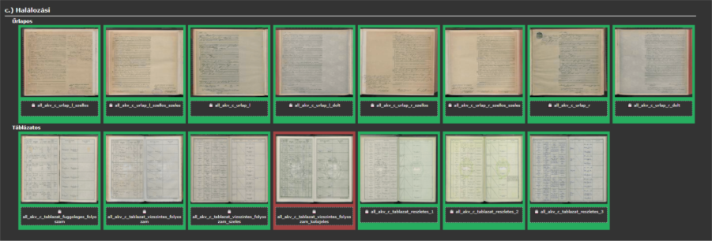
Overview of the different templates
Notes:
This is the overview of the different templates. The tabular and protocol-style pages are easy to recognize; however, there are also very similar structures that are more difficult to distinguish from one another.
In many cases, the different coats of arms visible in the background helped us identify the various structural types.

Slide 12
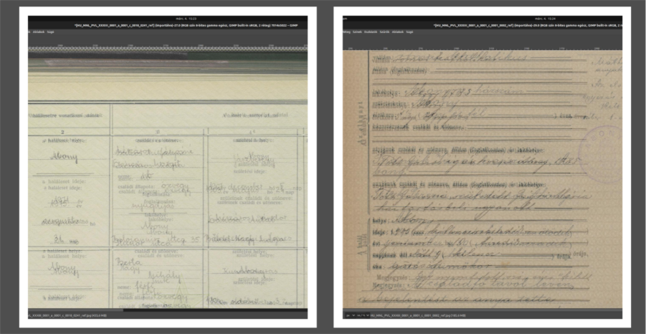
Illustration of the difference between two similar pages
Notes:
“The images shown are not ghosted; rather, they were created by overlaying two pages that appear almost identical at first glance. The purpose is to highlight the small but important differences that affect the applicability of the templates.”

Slide 13
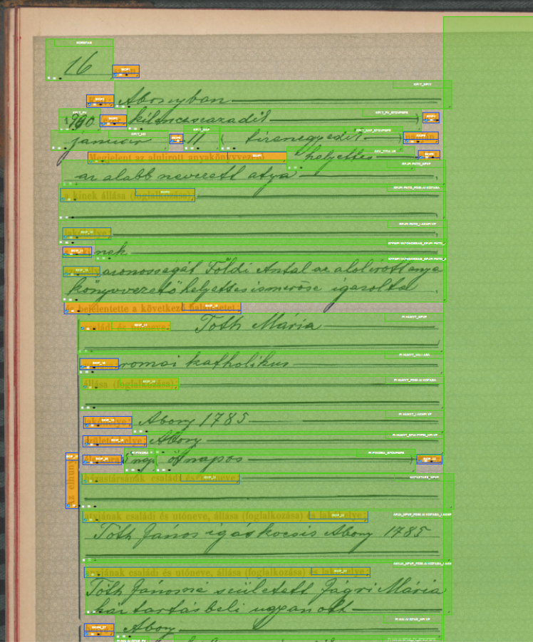
Detailed look at a template
Green Area: Fields containing handwritten information. These hold the actual data to be recorded, like names, dates, and places.
Orange Area: Pre-printed, static text that does not change from document to document, such as headers or template text.
Red Area: Shows the type of data expected in each field—telling the system what kind of information (e.g., name, year, town) should appear.
Purple Area: The part of the page that the system processes. Areas outside this—usually page edges or empty margins—are ignored, since they don’t contain relevant information.
Notes:
This image shows what a template looks like and explains the meaning of the different color codes.

Slide 14
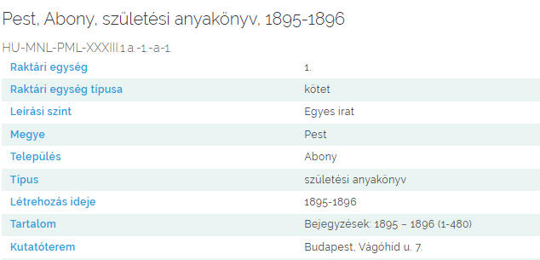
Result: Structured Data
The templates we created can be used on any document image that follows the same structural type. This allows us to:
Automatically sort large volumes of visually similar documents
Extract data in a structured way
Map the extracted data to the correct fields in the archival database
Notes:
The image on the right shows the result, as it will appear in the database. The different pieces of data are clearly separated.

Slide 15
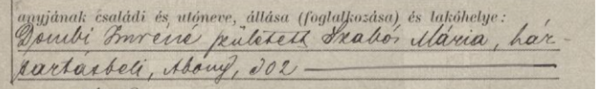
Overloaded fields
A real challenge
The civil registry clerk writes too much information in one place
Three or even more separate pieces of information in one continuous line
Task: to teach AI to split this information
Notes:
What is an overloaded field?
Every genealogist has seen them, often without noticing, because they’re easy for humans to read. But for machines, it’s a different story.
For example, a civil register form asks for the mother’s family name, given name, occupation, and residence. The clerk, however, often writes all of this in one continuous line, separated by commas.
Humans can easily see that this is actually three separate pieces of information: the mother’s name, her occupation, and her residence. But without proper training, AI reads it as a single line of text.
To make sure all information goes into the right fields in the searchable database, we need to teach the system how to split these complex entries correctly.

Slide 16
Separated information
Mother’s name: Dombi Imréné (born Szabó Mária)
Occupation: housewife
Residence: Abony 302
Notes:
This is what the separated information looks like – this is the result we want to achieve and we are still working on it.

Slide 17
Annotating Application – Creating Digital Training Material
The annotating application is a software tool that helps us teach artificial intelligence to read. It was first tested in 2023 by four MACSE members, who used it to annotate civil register pages.
The testing proved valuable in several ways:
It confirmed that the application can be effectively used by a larger community in a real working environment.
The training material created can be directly used in our current civil register project.
Notes:
In addition to the Template Builder, we developed another application, which also plays a very important role.: this is the annotating application.

Slide 18
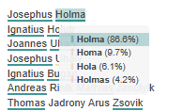

Hypotheses
Several possible solutions offered by AI
Confidence score
Compare these options with the original image and decide which one is correct
Role of human intelligence
Notes:
I’d like to introduce the audience to another very important concept: these are the hypotheses.”
Hypotheses are very important: when the system reads handwriting, it gives several possible readings, each with a confidence score showing how likely it is to be correct.
The researcher can compare these options with the original image and decide which one is correct. Often, a reading with 98% confidence is right, but sometimes a reading with only 60% confidence turns out to be accurate.
“We can see that human intelligence plays a decisive role in determining what we accept and what we don’t.”
On the left side of the image is the original text, and on the right side is the AI’s suggested reading with its probability score.”

Slide 19
The AI Team of the National Archives of Hungary
Zoltán Szatucsek (director)
Zsolt Záros (IT developer)
Zsolt Bánki (Head of Department)
Noémi Vadász, PhD (linguist, developer)
Kata Szűcs, PhD (Digital Humanities expert)
Emese Varga (Digital Humanities expert)
András Simon (IT expert)
Ildikó Szerényi (senior archivist)
Notes:
This was the first time I could speak on behalf of our AI team in more detail about our developments in front of genealogists. Finally, I would like to acknowledge the individuals whose work I have been able to present today.

Slide 20
Thank you for your attention
E-mail:
szatucsek.zoltan@mnl.gov.hu
szerenyi.ildiko@mnl.gov.hu
National Archives of Hungary

